Slide 1



CrossCheck: Combining Crawling and Differencing to Better Detect Cross-browser Incompatibilities in Web Applications
Shauvik Roy Choudhary, Mukul Prasad, Alex Orso
Georgia Institute of Technology
Fujitsu Labs of America

Slide 2

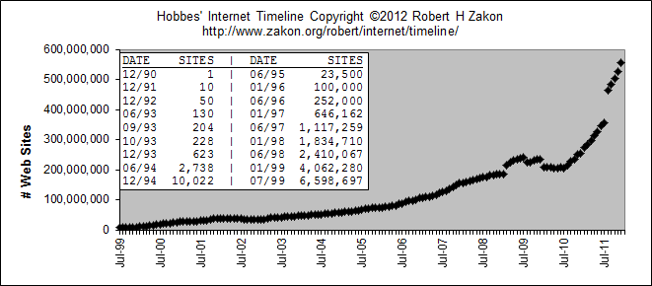
Move to the Web

Slide 3





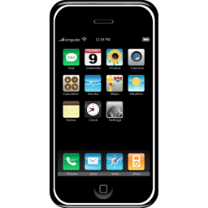





Multitude of Browsing Environments
Notes:
Subtle differences which lead to Cross-Browser Incompatibilities

Slide 4



Georgia Tech Website
Mozilla Firefox
Internet Explorer

Slide 5
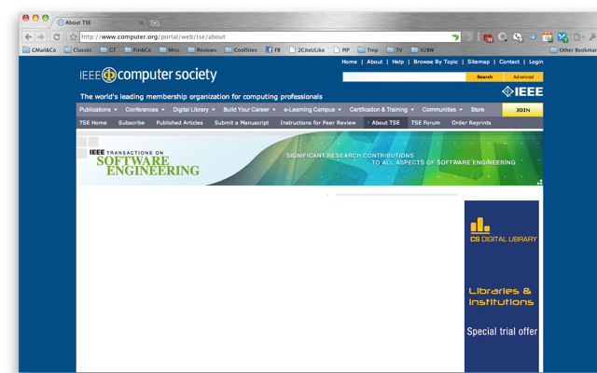
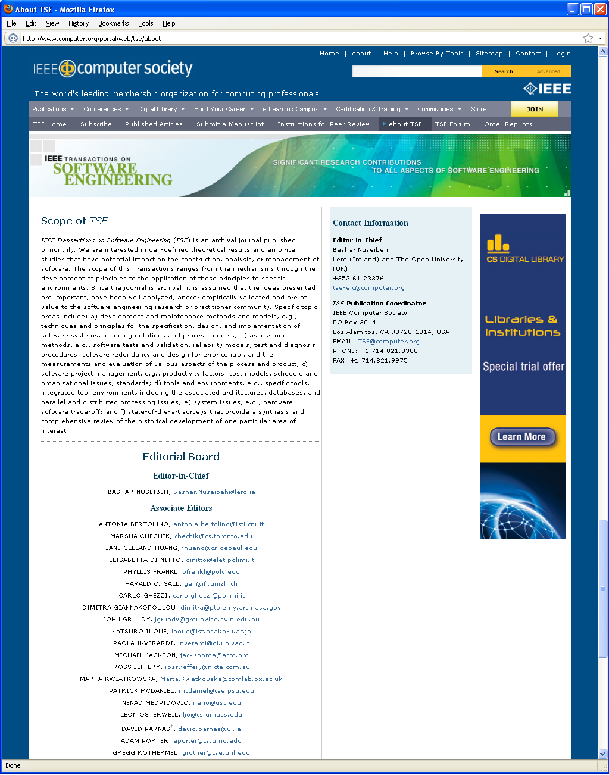
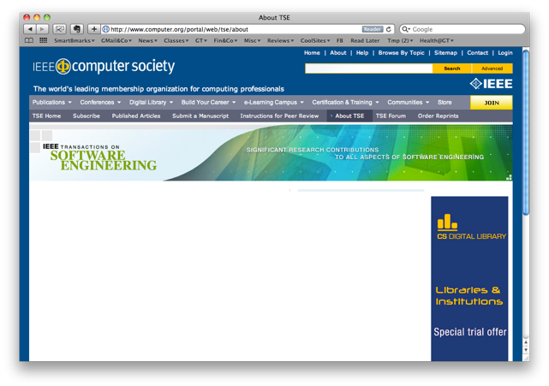
IEEE TSE Website
Notes:
Bigger but still cosmetic

Slide 6


Granta Books Website
Mozilla Firefox
Internet Explorer
?
?
Notes:
Menu and functionality associated with menu is missing.
Incompatibility leads to

Slide 7
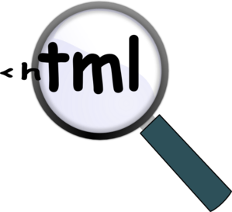

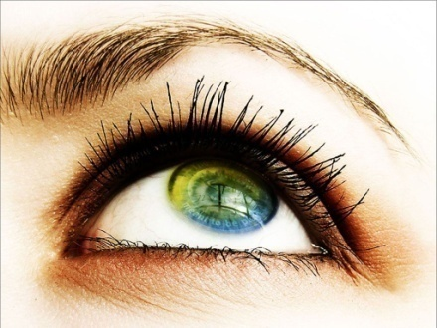
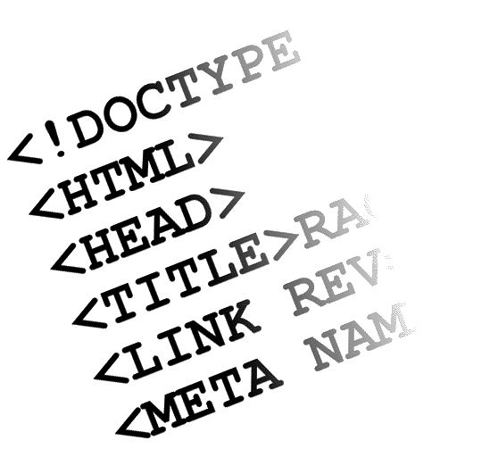



Manual inspection
is expensive
Modern apps have
many dynamic screens
DOM differs
between browsers
Goals &
Challenges
Work with browser
security controls
Mimic end user’s
perception
15 Sep 2010
3:15pm
?
Ignore variable elements
on webpage
Produce human
Consumable reports
Need automated
classification
Notes:
TODO:
Explain better (talk or slide) about relations between challenges
Relate challenges to motivating example

Slide 8
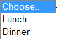
Running Example

Slide 9
Running Example

Slide 10
Running Example

Slide 11
Running Example

Slide 12
Running Example

Slide 13
Running Example

Slide 14



Running Example
1
Missing screen transitions

Slide 15
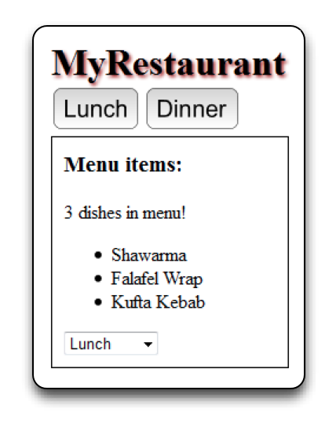
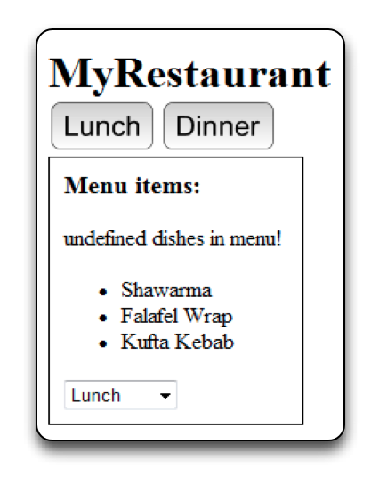
Running Example
2
Missing shadow
3
Wrong count
of items

Slide 16
Running Example
Some Definitions
Screen-level difference: visual difference that manifest on a specific page.
Trace-level difference: difference in the navigation between pages.

Slide 17
Running Example
Some Definitions
Cross-Browser Difference (CBD): observable difference between renderings of a particular element in two browsers.
Cross-Browser Incompatibility (XBI): common cause of a set of related CBDs.

Slide 18


A Tale of Two Techniques
WebDiff
Screen-level
differences
(graph matching, computer vision)
CrossT
Trace-level
differences
(graph isomorphism)

Slide 19


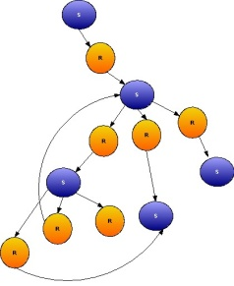
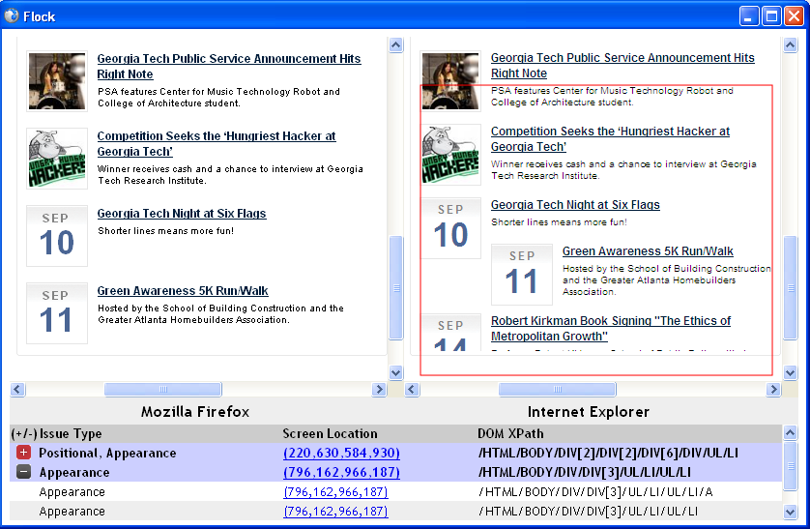


CrossCheck
Goal: To better detect both functional and visual XBIs by combining the two complementary techniques
High level view of the approach
≡
Cross-browser Error Report
Web Application
≡
1. Model Generation
2. Model Comparison
3. Report Generation

Slide 20

1. Model Generation
Screen Model
Screen Transition
Graph
Web Application
Screen image + geometries
DOM Tree
Screen image + geometries
Ajax Crawler
(Crawljax)
DOM Tree
Notes:
Crawled behavior has two components – STG and a model for each screen.

Slide 21

2a. Trace Level Comparison
STG
STG
Match Screen Transition Graphs from two browsers using graph isomorphism (both screens and transitions)
Output:
Pairs of matching screens → Perform Screen-level comparison
Unmatched Screens → Report Trace-level issue
Unmatched Transitions → Report Trace-level issue

Slide 22
2a. Trace Level Comparison
S₀
S₀’
S₁
S₂
S₁’
S₂’

Slide 23
2b. Screen Level Comparison
Given a pair of matched screens (from prev. step)
Compare DOMs to find matching elements
Use MatchIndex
f(xPath, coords, zindex, visibility etc.)
Output:
Pairs of matched DOM nodes (corr. screen elements) → for visual comparison
Unmatched DOM nodes if any
Match DOMs
Corr. Screen elements
Notes:
MatchIndex to figure out corresponding elements across browsers.

Slide 24
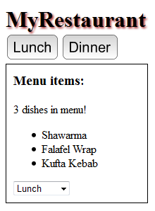
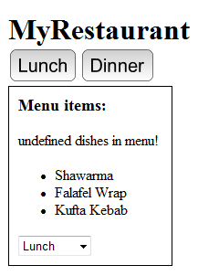
2b. Screen Level Comparison
Like-colored (matched) screen-elements compared through visual comparison
Notes:
MP: (matched) -> (DOM matched)

Slide 25
Visual Comparison
Do these screen elements look the same ?
≡ ?
Features Used:
Size difference
Position difference/ displacement
Absolute size
Text value difference (based on DOM)
χ² –Image distance (between images of 2 elements)
Extract Features
Machine Learning
based Classifier
YES
NO
Notes:
By visual comparison….

Slide 26



Training the classifier (offline – single time)
False
True
Feature Extraction
Supervised Machine Learning
Set of screen-element comparison instances
Machine Learning based Classifier
Screens with (known)
Cross-Browser Differences

Slide 27
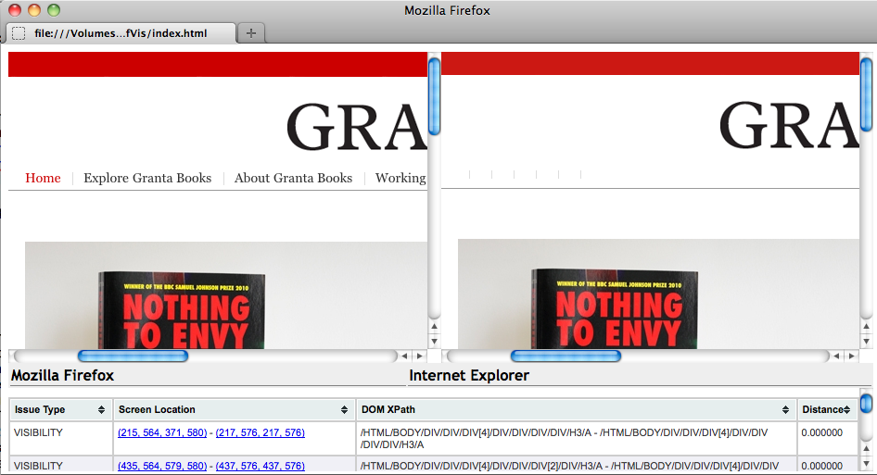
3. Report Generation (Clustering)
Notes:
Goals :
- Group related CBDs into XBIs
- Map back to elements
We use the DOM hierarchy to cluster the related CBDs into XBIs
Developed clustering algorithm based on element’s DOM tree proximity.

Slide 28
Empirical Evaluation
RQ1 (Effectiveness) Can CrossCheck identify different kinds of CBDs in real-world web applications and correlate them to identify XBIs?
RQ2 (Improvement) How effective is CrossCheck when compared to CrossT and WebDiff?

Slide 29
Experimental Setup
Subjects:
Web App | URL | Type | S | T | DOM Nodes
 |  |  |  |  | min | max | avg
Restaurant | http://localhost/restaurant | Information | 3 | 8 | 785 | 846 | 821
Organizer | http://localhost/organizer | Productivity | 13 | 99 | 10001 | 27482 | 13051
GrantaBooks | http://grantabooks.com | Publisher | 9 | 8 | 15625 | 37800 | 25852
DesignTrust | http://designtrust.org | Business | 10 | 20 | 7772 | 26437 | 18694
DivineLife | http://sivanandaonline.org | Spiritual | 10 | 9 | 9082 | 140611 | 49886
SaiBaba | http://shrisaibabasansthan.org | Religious | 13 | 20 | 524 | 42606 | 12162
Breakaway | http://breakaway-adventures.com | Sport | 9 | 18 | 8191 | 45148 | 13059

Slide 30
Experimental Setup
Procedure:
Used latest versions of Firefox (v7.0.1) and Internet Explorer (v9.0.3)
Ran CrossCheck on the subjects to perform the various phases of the technique
Manually checked results for false positives and negatives

Slide 31
RQ1: Effectiveness
Application | Trace | Position | Size | Visibility | Text | Appearance | CBDs | XBIs
Restaurant | 4 | 0 | 2 | 0 | 2 | 3 | 11 | 9
Organizer | 14 | 0 | 42 | 5 | 0 | 1 | 62 | 18
GrantaBooks | 16 | 0 | 0 | 11 | 0 | 1 | 28 | 16
DesignTrust | 4 | 2 | 39 | 2 | 0 | 146 | 189 | 130
DivineLife | 7 | 0 | 0 | 3 | 1 | 70 | 81 | 73
SaiBaba | 2 | 5 | 31 | 7 | 3 | 55 | 103 | 89
Breakaway | 0 | 13 | 132 | 0 | 0 | 246 | 391 | 268
TOTAL | 47 | 20 | 246 | 28 | 6 | 522 | 865 | 603

Slide 32
RQ1: Effectiveness
Application | Trace | Position | Size | Visibility | Text | Appearance | CBDs | XBIs
Restaurant | 4 | 0 | 2 | 0 | 2 | 3 | 11 | 9
Organizer | 14 | 0 | 42 | 5 | 0 | 1 | 62 | 18
GrantaBooks | 16 | 0 | 0 | 11 | 0 | 1 | 28 | 16
DesignTrust | 4 | 2 | 39 | 2 | 0 | 146 | 189 | 130
DivineLife | 7 | 0 | 0 | 3 | 1 | 70 | 81 | 73
SaiBaba | 2 | 5 | 31 | 7 | 3 | 55 | 103 | 89
Breakaway | 0 | 13 | 132 | 0 | 0 | 246 | 391 | 268
TOTAL | 47 | 20 | 246 | 28 | 6 | 522 | 865 | 603

Slide 33
RQ2: Improvement
Application | CrossCheck |  |  |  | CrossT |  | WebDiff
 | Rep. | Conf. | Trace | Screen | Rep. | Conf. | Rep. | Conf.
Restaurant | 11 | 11 | 4 | 7 | 11 | 6 | 11 | 5
Organizer | 62 | 50 | 14 | 36 | 202 | 14 | 28 | 8
GrantaBooks | 28 | 27 | 16 | 11 | 348 | 16 | 10 | 9
DesignTrust | 189 | 27 | 4 | 23 | 68 | 0 | 98 | 21
DivineLife | 81 | 13 | 7 | 6 | 1741 | 10 | 67 | 8
SaiBaba | 103 | 36 | 2 | 34 | 188 | 3 | 42 | 5
Breakaway | 391 | 150 | 0 | 150 | 306 | 0 | 291 | 63
TOTAL | 865 | 314 | 47 | 267 | 2864 | 49 | 547 | 119

Slide 34
RQ2: Improvement
Application | CrossCheck |  |  |  | CrossT |  | WebDiff
 | Rep. | Conf. | Trace | Screen | Rep. | Conf. | Rep. | Conf.
Restaurant | 11 | 11 | 4 | 7 | 11 | 6 | 11 | 5
Organizer | 62 | 50 | 14 | 36 | 202 | 14 | 28 | 8
GrantaBooks | 28 | 27 | 16 | 11 | 348 | 16 | 10 | 9
DesignTrust | 189 | 27 | 4 | 23 | 68 | 0 | 98 | 21
DivineLife | 81 | 13 | 7 | 6 | 1741 | 10 | 67 | 8
SaiBaba | 103 | 36 | 2 | 34 | 188 | 3 | 42 | 5
Breakaway | 391 | 150 | 0 | 150 | 306 | 0 | 291 | 63
TOTAL | 865 | 314 | 47 | 267 | 2864 | 49 | 547 | 119

Slide 35
Empirical Evaluation
RQ1: Effectiveness
CrossCheck was indeed able to find CBDs and grouped them to XBIs
Application | CrossCheck |  |  |  | CrossT |  | WebDiff
 | Rep. | Conf. | Trace | Screen | Rep. | Conf. | Rep. | Conf.
Restaurant | 11 | 11 | 4 | 7 | 11 | 6 | 11 | 5
Organizer | 62 | 50 | 14 | 36 | 202 | 14 | 28 | 8
GrantaBooks | 28 | 27 | 16 | 11 | 348 | 16 | 10 | 9
DesignTrust | 189 | 27 | 4 | 23 | 68 | 0 | 98 | 21
DivineLife | 81 | 13 | 7 | 6 | 1741 | 10 | 67 | 8
SaiBaba | 103 | 36 | 2 | 34 | 188 | 3 | 42 | 5
Breakaway | 391 | 150 | 0 | 150 | 306 | 0 | 291 | 63
TOTAL | 865 | 314 | 47 | 267 | 2864 | 49 | 547 | 119
RQ2: Improvement
CrossCheck detected more differences than WebDiff (62% more) and CrossT (84% more)
CrossCheck reported fewer false positives than WebDiff (15% less) and CrossT (34% less)

Slide 36



Future Work
Improved computer vision algorithms to reduce false positives and diminish noise sources
Perform user studies for feedback from real web developers to further improve our technique
Study behavioral equivalence across different platforms, especially mobile
Notes:
Reduced numbers of the visual false positives.

Slide 37
Related Work
Industrial tools
BrowserShots, Adobe Browser Lab, MS Expression Web
Test Suites for Web Browsers – Acid and test262
Eaton & Memon [IJWET’07]
Precursors to CrossCheck
WebDiff: Roy Choudhary, Versee and Orso [ICSM’10]
CrossT: Mesbah and Prasad [ICSE’11]

Slide 38
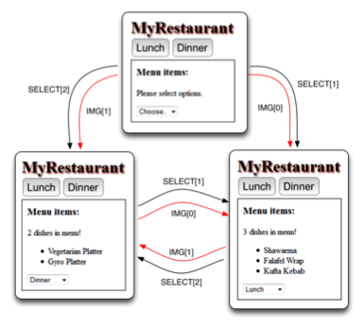
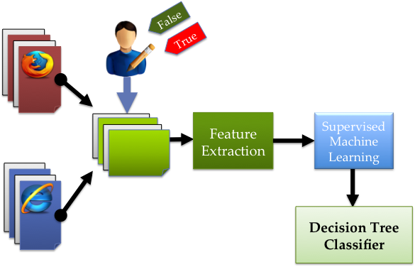



Contributions of CrossCheck
Detects both visual
and trace-level XBIs
Machine-learning based
automated detection
Cluster CBDs into
meaningful XBIs
Empirical evaluation
shows effectiveness

